Slide 1



3 “C” TO CHOOSE i68
1. COMMITTED to deliver QUALITY services
2.COSTUMERS full satisfaction
3. COMPETENCIES defined

Slide 2
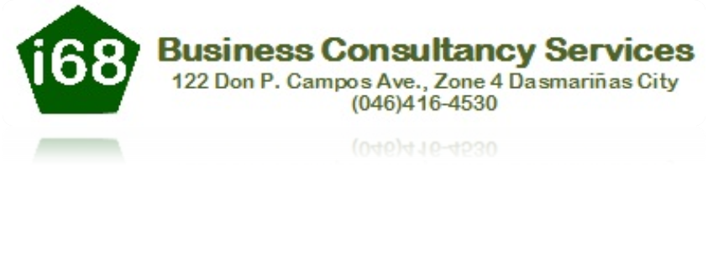
I68 Business Consultancy Services is a company specializing in providing professional services in the areas of Accounting, Tax Compliance, Business Registration and other business related matters.
It has 2 operating divisions and one (1) sister company namely: T13 Trading that specializes in trophies, plaques and selected novelties.
PRIMARY PURPOSE
Engage in providing professional and quality services aimed at enhancing your company’s efficiency, status and productivity.
Become the leading business and consultancy firm in the Philippines, through providing services that is imbued with moral and ethical standards.

Slide 3
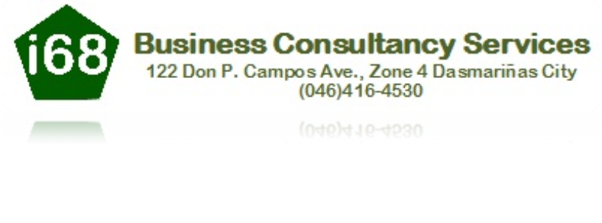
Vision and Objectives
I68 Business Consultancy Services shall be a company that focuses on employee development, their families and consequently to society, customer satisfaction premised on professionalism, consistent with Filipino values and mores.
Notes:
Our Mission is to ……..

Slide 4
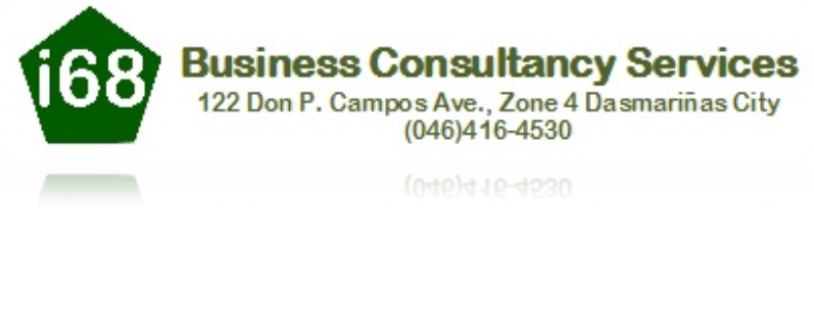

WHAT WE OFFER
ACCOUNTING DEPARTMENT:
-Filing of monthly, quarterly and annual tax returns
- Auditing (Corporations and Cooperative)
-Processing of Business Permit, Mayor’s Permit, DTI, Barangay Certificate, SEC and other business related matters
Notes:
Social Services
Accounting
Sales and Marketing

Slide 5
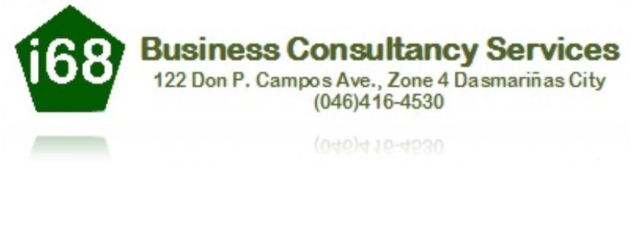
SOCIAL SERVICES
1. STAFF DEVELOPMENT
Our staff development program offers different kinds of approaches encompassing a range of people, interests and approaches. Those who engage in professional development share a common purpose of enhancing their ability to do their work. At the heart of staff development is the individual's interest in lifelong learning and increasing their own skills and knowledge. This program includes;
Coaching - to enhance a person’s competencies in a specific skill area by providing a process of observation, reflection, and action.
Communities of Practice - to improve professional practice by engaging in shared inquiry and learning with people who have a common goal
Lesson Study - to solve practical dilemmas related to intervention or instruction through participation with other professionals in systematically examining practice
Mentoring - to promote an individual’s awareness and refinement of his or her own professional development by providing and recommending structured opportunities for reflection and observation
Reflective Supervision - to support, develop, and ultimately evaluate the performance of employees through a process of inquiry that encourages their understanding and articulation of the rationale for their own practices
Technical Assistance - to assist individuals and their organization to improve by offering resources and information, supporting networking and change efforts

Slide 6
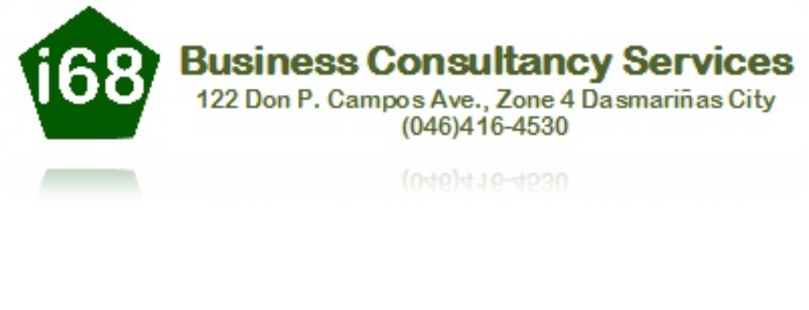
SOCIAL SERVICES
2. ISO CONSULTANCY FOR CERTIFICATION
We provides expert consulting, training and auditing services for ISO 9001 Quality Management Services and ISO 14001 Environmental Management System. Our focus is on providing timely and cost-effective solutions for your system development, implementation, training and auditing needs.
Our goal is to help you develop business management systems that besides getting certified, improve operational performance and customer satisfaction, reduce business risks and increase profitability.
3. OTHERS
Good Housekeeping, The “5s” way
We provide company’s and industries orientation seminar on Good Housekeeping , the 5’s way for the following benefits; Effective use of resources, Improve morale and productivity, Safeguard product “Quality”, and Promote safety and health.
Emergency Preparedness and Response, We provide company’s and industries orientation seminar on Good Housekeeping for the following advantages;
Establish, implement and maintain procedures
Respond to actual emergency situations and accidents and prevent or mitigate associated adverse environmental impacts
Periodically review, where necessary, revise procedures after the occurrence
Periodically test procedures, where practicable

Slide 7

SALES AND MARKETING
1. T13 TRADING : TROPHIES, MEDALS AND PLAQUES
T13 Trading is considered as a major player in the Philippine Services Company with the widest depth & breadth of products and services coupled with the ability to deliver anywhere in the Philippines while providing its clients with the best “After sales service” in the industry.
PRODUCTS & SERVICES:
Engraving, etching and dye sublimation on variety of materials, including: metal or glass acrylic and more….
Our art department can provide you complete flexibility in designing your awards/ medals including: colored logos, signatures, photos and design.
We can also provide, in-house designs in addition to all our catalogued items, utilizing our wood shop, if applicable, to meet any and all of your needs.

Slide 8

ON-GOING AND ACCOMPLISHED PROJECTS
1. Financial and Accounting
Assistance/Resolution of Tax Cases
Preparation of (Tax Returns, Federal Tax Returns, Books of Accounts, Audited Financial Statements, General Information Sheets)
Filing of Tax Returns, Financial Statements
2. Sales and Marketing
Delivery of Trophies, Medals and Plaques

Slide 9

COMPETITIVE AFFLIATIONS
Philippine Institute of Certified Public Accountants, (PICPA)
Board of Accountancy, (BOA)
Philippine Philosophical Society, (PPC)
Securities and Exchange Commission, (SEC)
Bureau of Internal Revenue, (BIR)
Insurance Commission, (IC)
Cooperative Development Authority, (CDA)
Department of Social Welfare and Development, (DSWD)
Department of Health, (DOH)

Slide 10
LIST OF CLIENTS
Accounting Department
ABKD Food Corner
A.A. De Lima General Merchandise
Asian Star Realty
Duplistar
RG Colors
Roviline
4. Bapet Commercial
5. Corazon Reyes
6. Daireen Trading
7. DBJ Trading
8. Dela Cuesta Apartment
9. DJVP Trading
10. Driftwoods Sports Park
11. Fringe Benefits Production
12. G. C. Sergio Law Office
13. GPQ Clinic
14. Ilbacca Enterprises

Slide 11

15. Innovest Realty
16. Jia Hua Chemicals
17. JMJ Optical Clinic
18. Jocrom Driving Services
19. Joelette’s Salon/Water Station
20. Julita Mendoza, Glemendz Building
21. Katuwang sa Buhay (Lending)
22. KBDR Junkshop
23. KOPH Trans and Tours
24. La Cadeau Asia Inc
25. LP Sari-sari Store
26. Luvtech Electronics Center
27. Marawi Leisure Park Inc
Mount Sea Resort
Tanza Oasis Resort
28. Noaj’s Car Care & Accessories Center
29. Nonima Enterprise/Bossnik
30. Palmas Del Sol Resort

Slide 12
15. Innovest Realty
16. Jia Hua Chemicals
17. JMJ Optical Clinic
18. Jocrom Driving Services
19. Joelette’s Salon/Water Station
20. Julita Mendoza, Glemendz Building
21. Katuwang sa Buhay (Lending)
22. KBDR Junkshop
23. KOPH Trans and Tours
24. La Cadeau Asia Inc
25. LP Sari-sari Store
26. Luvtech Electronics Center
27. Marawi Leisure Park Inc
Mount Sea Resort
Tanza Oasis Resort
28. Noaj’s Car Care & Accessories Center
29. Nonima Enterprise/Bossnik
30. Palmas Del Sol Resort

Slide 13
31. PL Pabalan Construction
32. Pre-Eminent Artist’s Center
33. Queencherry Construction Supply
34. RA Ileto Construction
35. RDO Dasma East Corporation
36. Sagena Toy Store
37. Sonjinfit Trading
38. Tagaytay All Alpha Landholdings Corp Development
39. Tagaytay Christian Academy
40. Tagaytay Veggies and Bloom
41. Vida Agri
42. Yuceepek Corporation
43. Precious Bounty Travel and Tours

